Slide 1
Text Analysis on Reverse Migration in India due to Covid-19
PPOL 566: Data Science III – Advanced Modelling Techniques
By: Sonali Subbu Rathinam
Net ID : ss4608

Slide 2
Research Question
To infer sentiments and topics from news articles about the covid induced domestic migration crisis in India in 2020.
Sentiment Analysis has been implemented using VADER and TextBlob
Topic Modelling will be implemented using LDA
Topics and sentiments can help in identifying issues that migrant workers face, and draft policies to provide them with economic and social protection.
Replication of Agarwal and Sarkar’s research paper – ‘Topical analysis of migration coverage during lockdown in India by mainstream print media’ (2020)

Slide 3
Background
The Indian government imposed its first country-wide lockdown due to Covid-19 in March 2020.
Almost all Indians in the unorganized informal sector lost their jobs due to the immediate closure of factories and markets.
Lack of alternate livelihood, and due to anxiety about the pandemic, millions of migrant workers fled from urban areas to their rural homes.
Many migrant workers travelled thousands of miles on foot.
The biggest domestic migration crisis the country ever witnessed since its Independence in 1947.

Slide 4
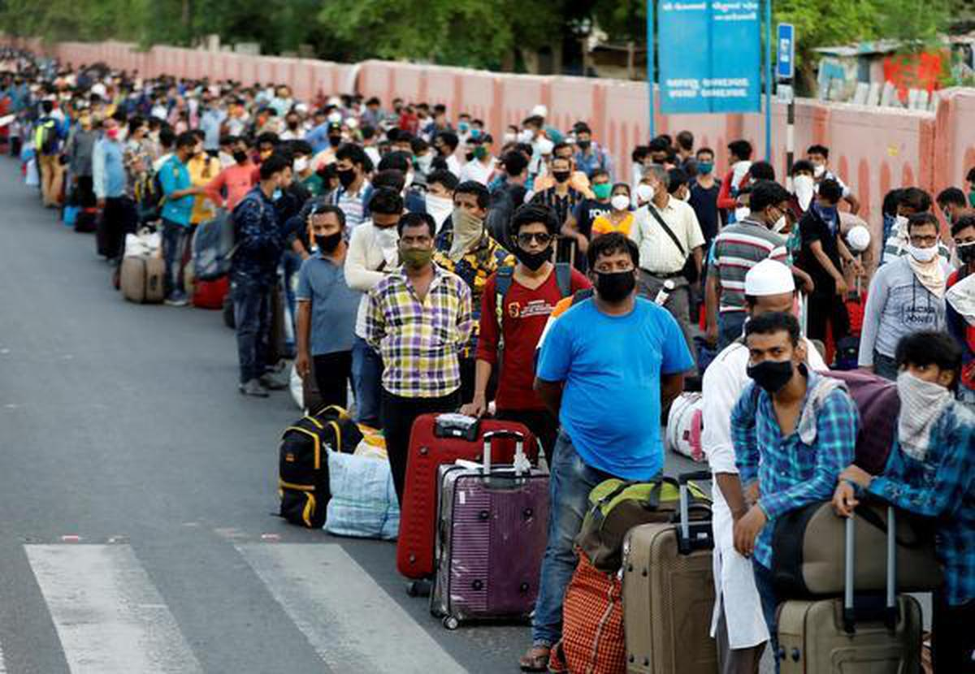
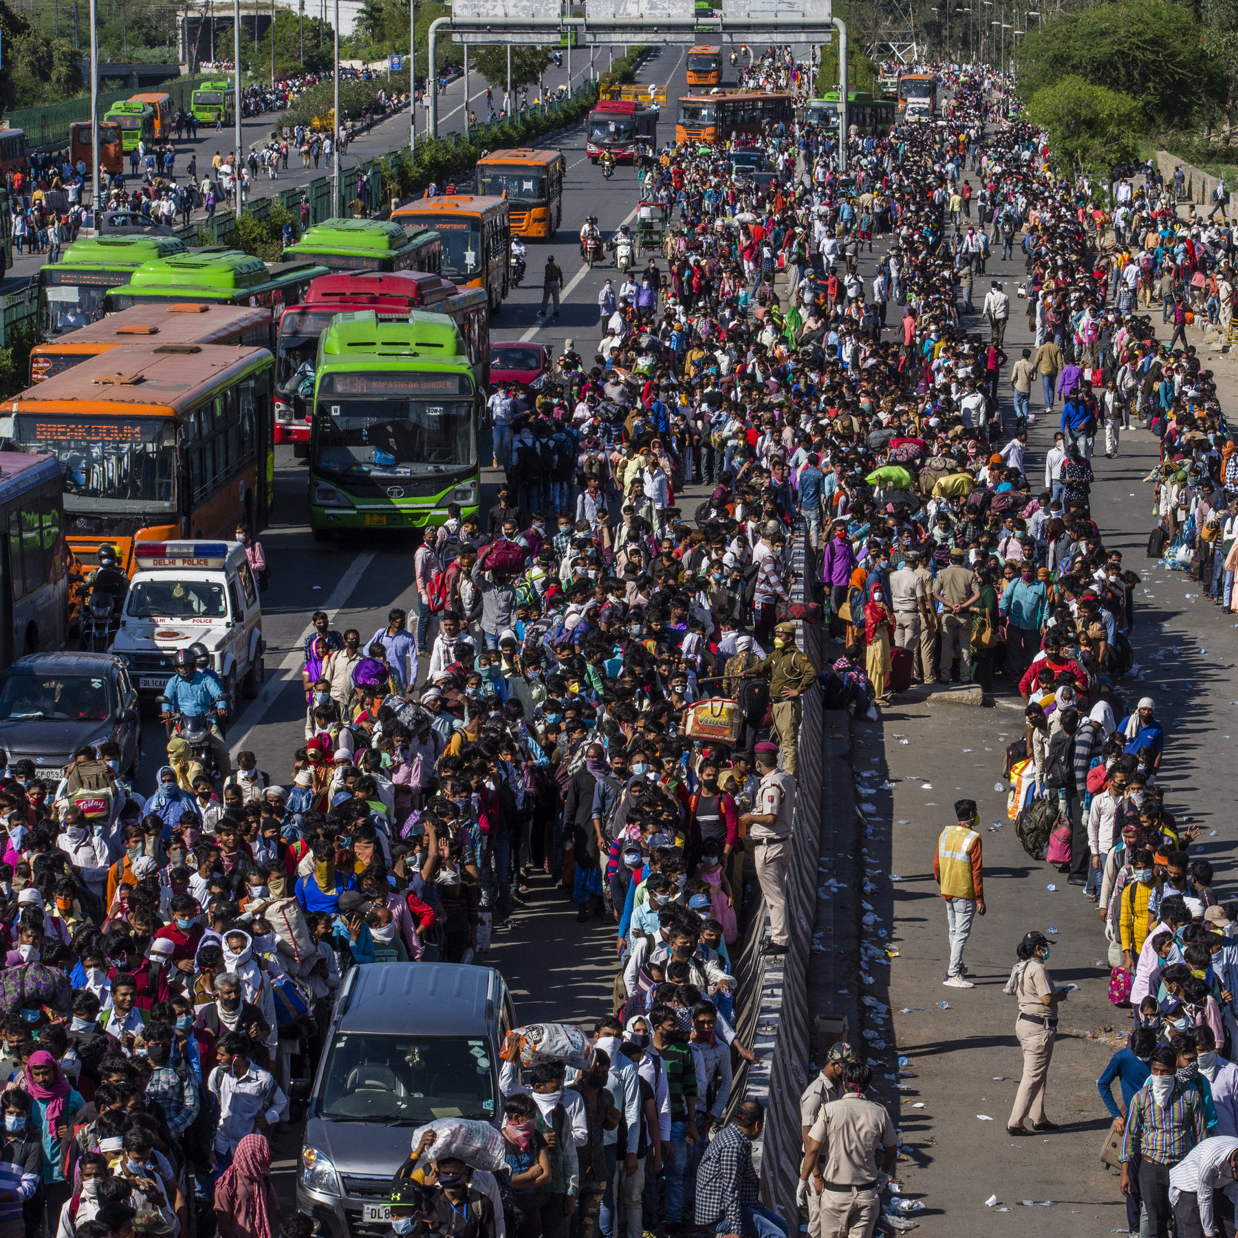
Background - Pictures to help understand the context better
Source : The Hindu Business Line
Source : New York Times

Slide 5
Data Source
Same dataset that authors used in the replication research paper,
The authors manually collected news articles from ‘The Times of India’ and ‘The Hindu’
Time Period : May - June 2020
Terms : migrants, migration, lockdown, COVID-19, pandemic
Important Features : Article Title, Article Text, Summary, Keywords
Article Text is the most important feature, as it is the most informative variable in the corpus
No Missing Values in the data

Slide 6
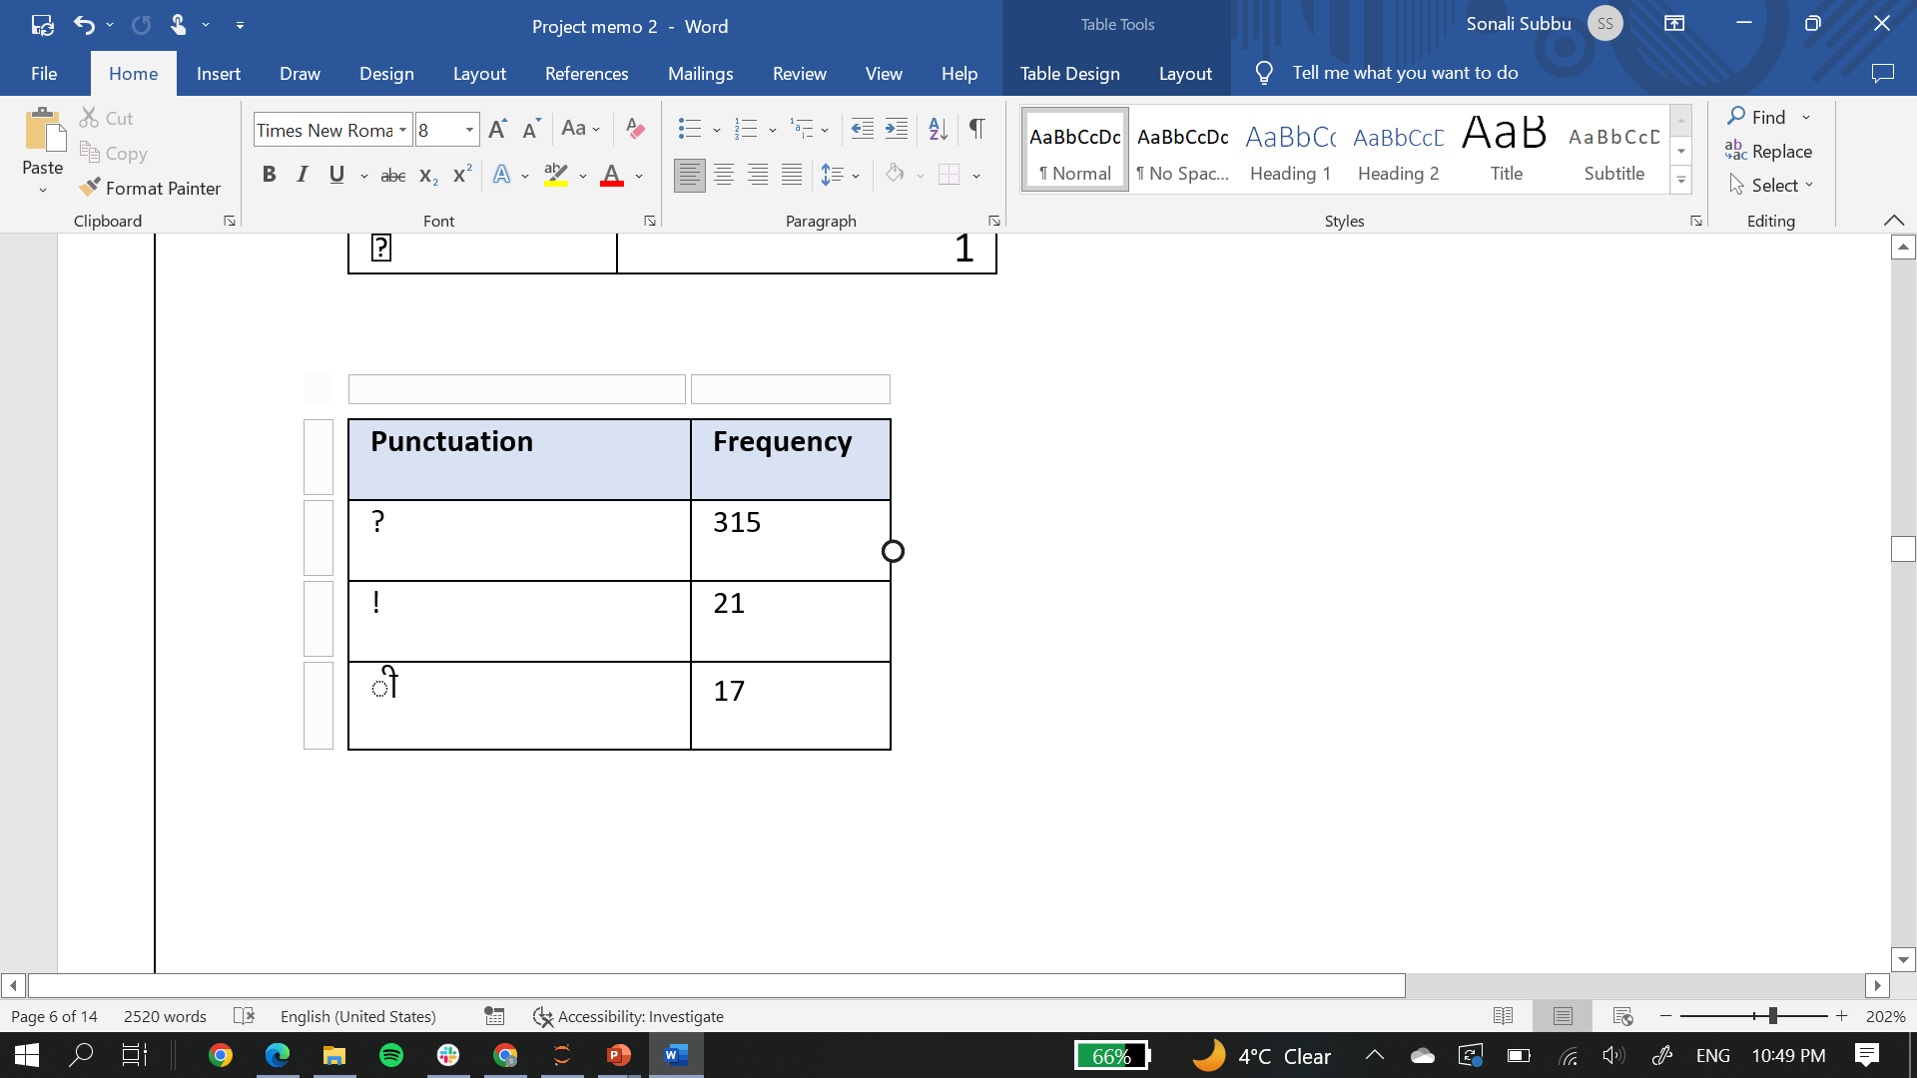
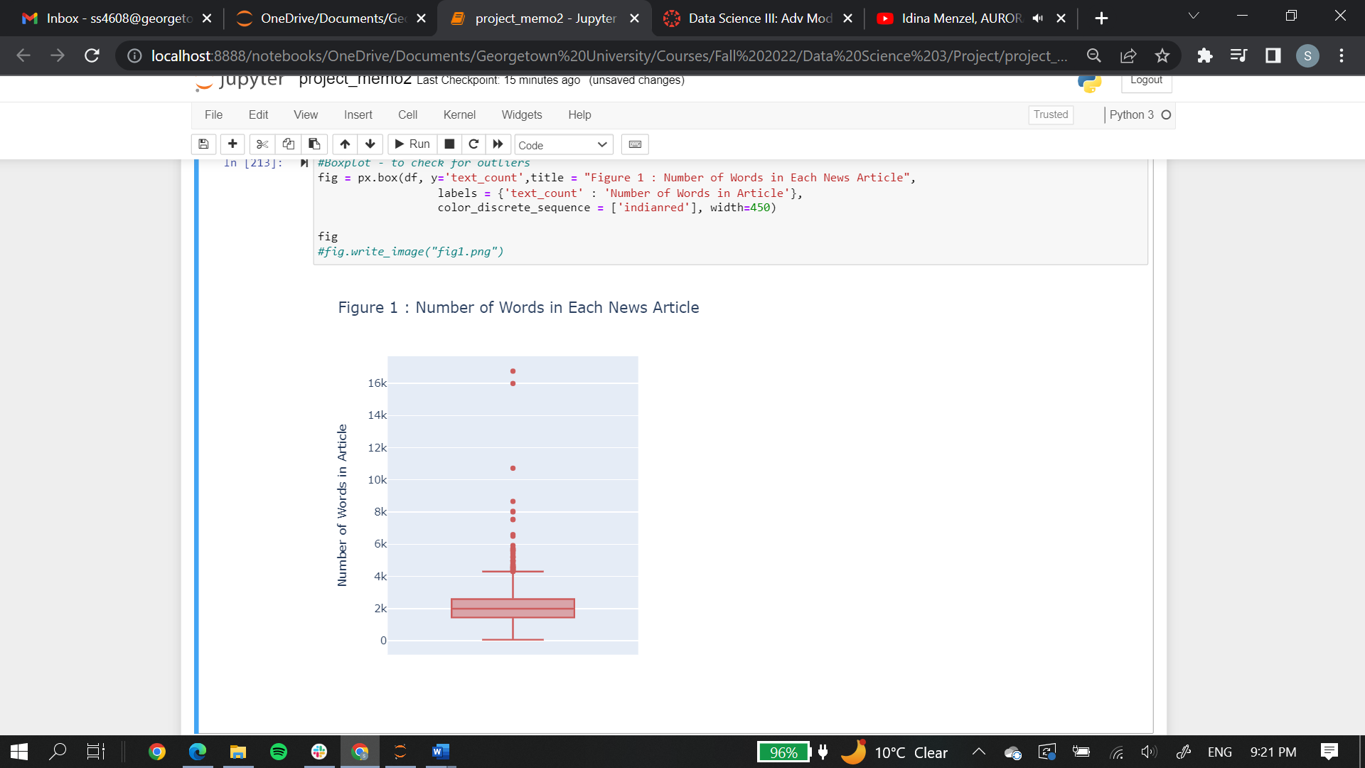
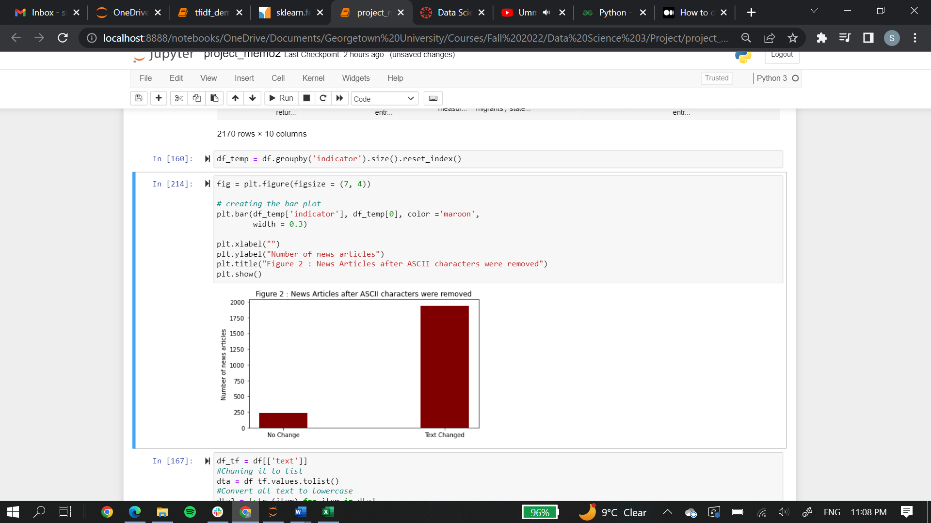
EDA and Data Pre-Processing
Analysis of summary statistics of article text variable
Checking for punctuation frequency
Removing Hindi diacritics
Lemmatization using WordNetLemmatizer from the NLTK module
`
Table 1 : Some punctuations and their frequencies
Figure 1 :Number of Words in each Article
Figure 2 :News Articles after ASCII characters were removed

Slide 7
Sentiment Analysis Implementation
Sentiment Analysis using VADER was chosen as it informs how positive/negative a sentiment is. The TextBlob lexicon has been used to check if results match.
Sentiment Analysis was performed on the article text variable
The overall sentiment in articles related to reverse migration indicate the overall perspective readers are most likely to have. This may be important as there was a large amount of donation to migrant workers and organizations that work for their benefit.

Slide 8
Topic Modelling Implementation
Topic Modelling using LDA will be used as it generates topics based on conditional probability estimates, The top ‘k’ words from TF-IDF will be used for topic modelling with LDA.
Topic Modelling will be performed on both the article text and article summary column
Uncovering important topics would highlight the most important issues that migrant workers face, and what factors were responsible for their reverse migration.

Slide 9
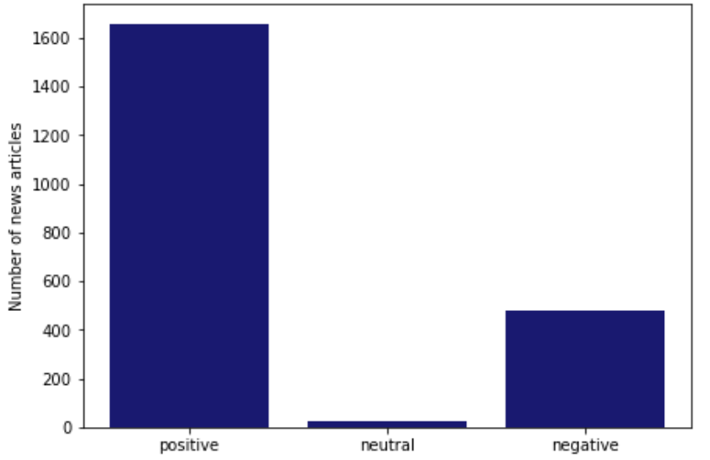
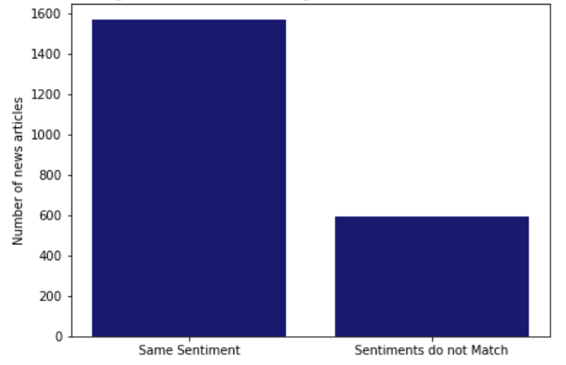
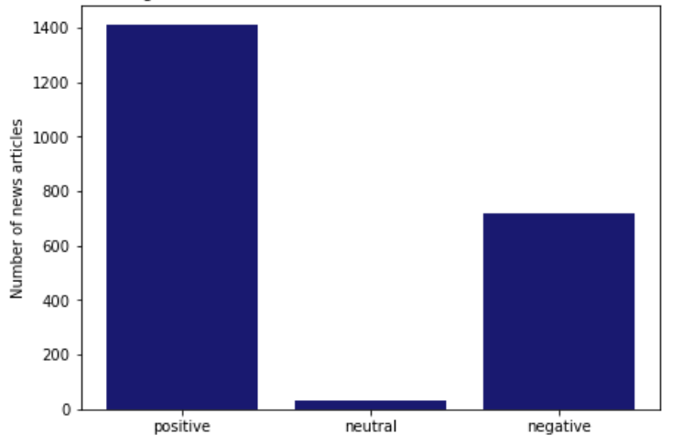
Sentiment Analysis Results
Sentiment Analysis results from VADER and TextBlob produced similar results. From Figure 5, it is clear that both the methods classified articles with the same sentiment for the most part.
Both the lexicons showed that most articles had largely positive sentiments. This is in clear contradiction to the domain knowledge.
Figure 3: Distribution of VADER Sentiments
Figure 4 : Distribution of TextBlob Sentiments
Figure 5 : Sentiment Analysis comparison of VADER and TextBlob

Slide 10
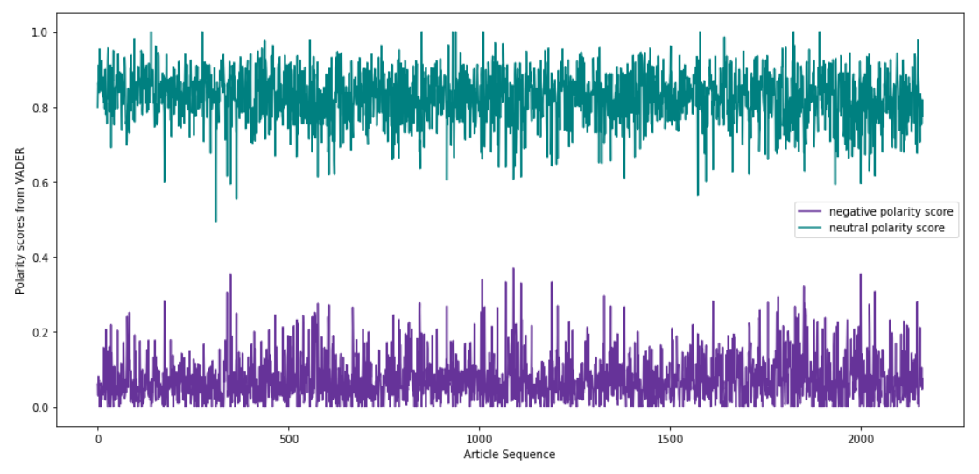
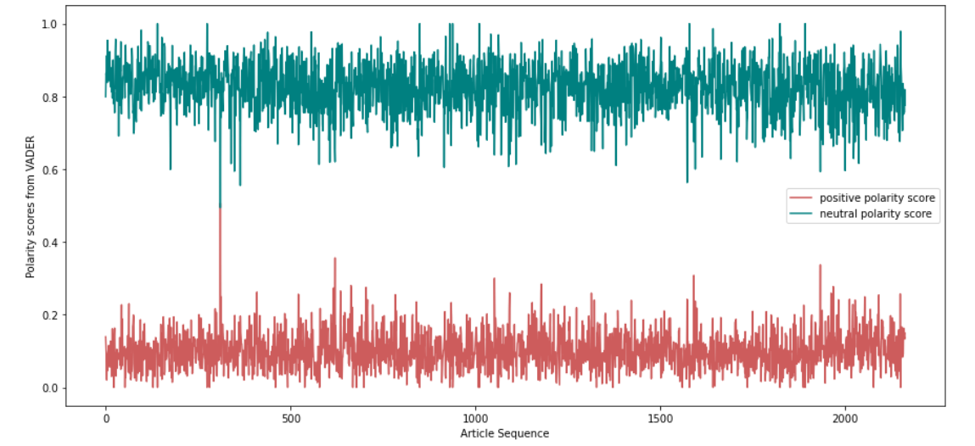
Sentiment Analysis Results
However, by visualizing the individual negative and positive polarity probabilities from VADER with the neutral probability, it can be inferred that there is a higher probability of neutral words, but on classification of sentiments, they seem to be positive/negative. This shows that most words are not very highly positive or negative.
Figure 6: Polarity Probabilities from VADER

Slide 11
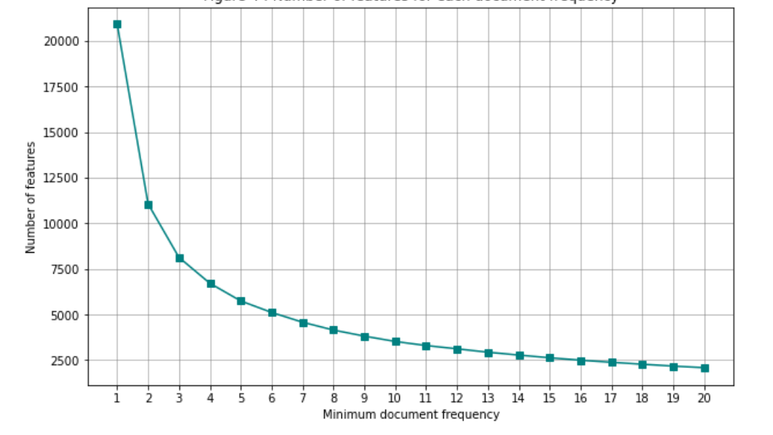
Topic Modelling Partial Results
As of now, TF-IDF vectorization has been performed to identify the k-top words to be used in the LDA algorithm. Figure 7 showed that 3 would be an appropriate minimum document frequency.
Figure 7: Number of features for each document frequency in TF-IDF

Slide 12
Conclusion and Limitations
Topic Modelling using top ‘k’ words to be conducted
Sentiment Analysis interpretation shouldn’t be limited to sentiment classification, it must also include the individual positive/negative scores.
The project is limited to English news sources, and analysis from regional/locally circulated newspaper may produce different results. However, text analysis on these languages are very difficult due to translation issues.
Data is limited to the first lockdown in India, There were other lockdowns (both at the national and state level) based on the rise in covid cases, and they contributed to the continuation of the covid induced reverse migration.

Slide 13
Thank You
Any Questions ?
Slides created using Slidesgo

